Slide 1
Machine learning review
DATA3320

Slide 2
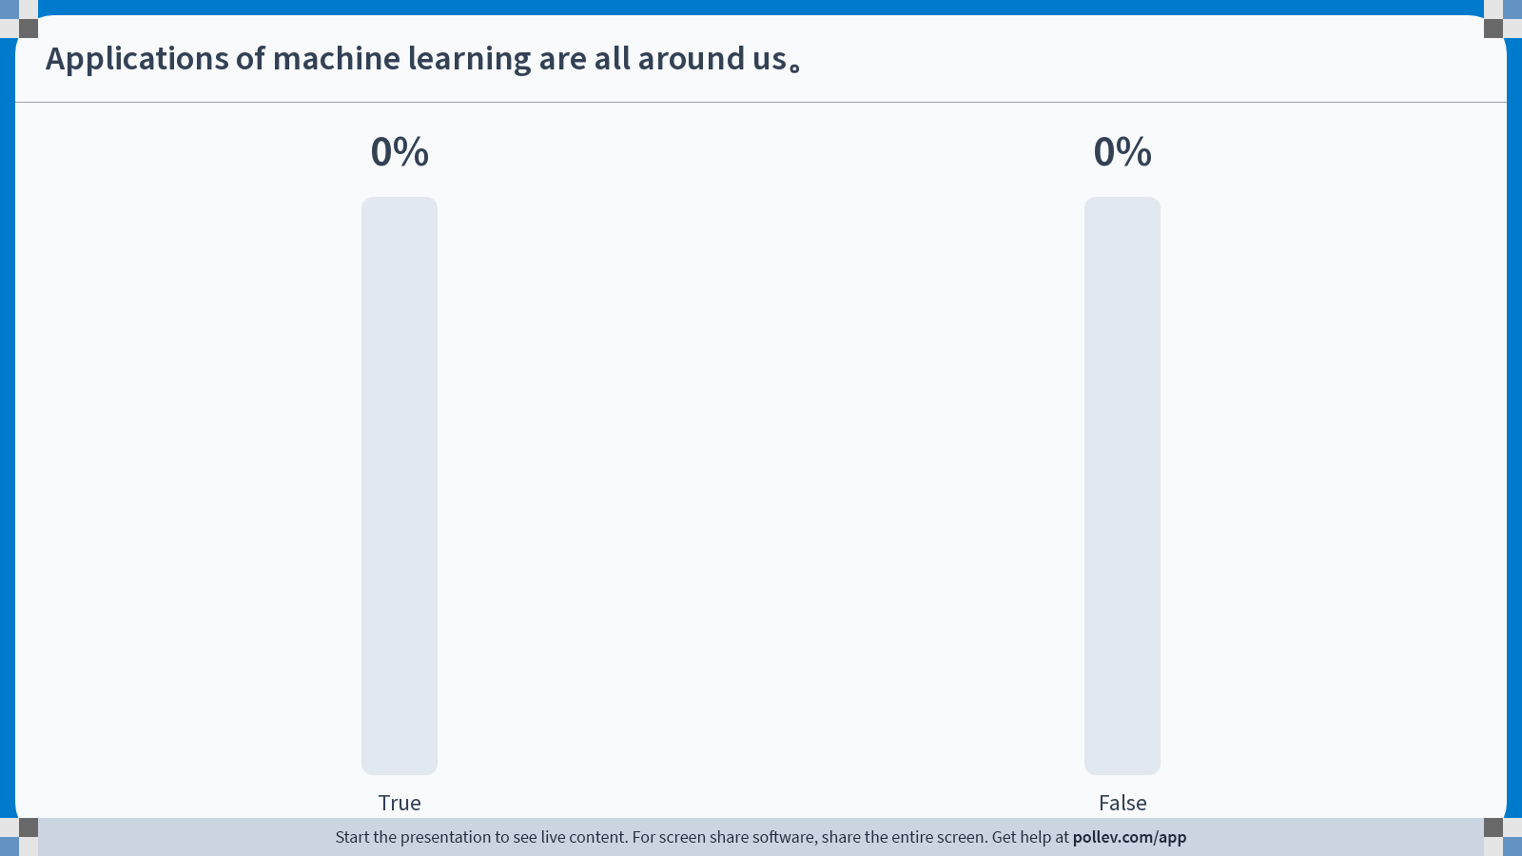
Notes:
Poll Title: Do not modify the notes in this section to avoid tampering with the Poll Everywhere activity. More info at polleverywhere.com/support Applications of machine learning are all around us。 https://www.polleverywhere.com/multiple_choice_polls/fTjaDxASEGPtZ5fxH6k7o?state=opened&flow=Default&onscreen=persist

Slide 3
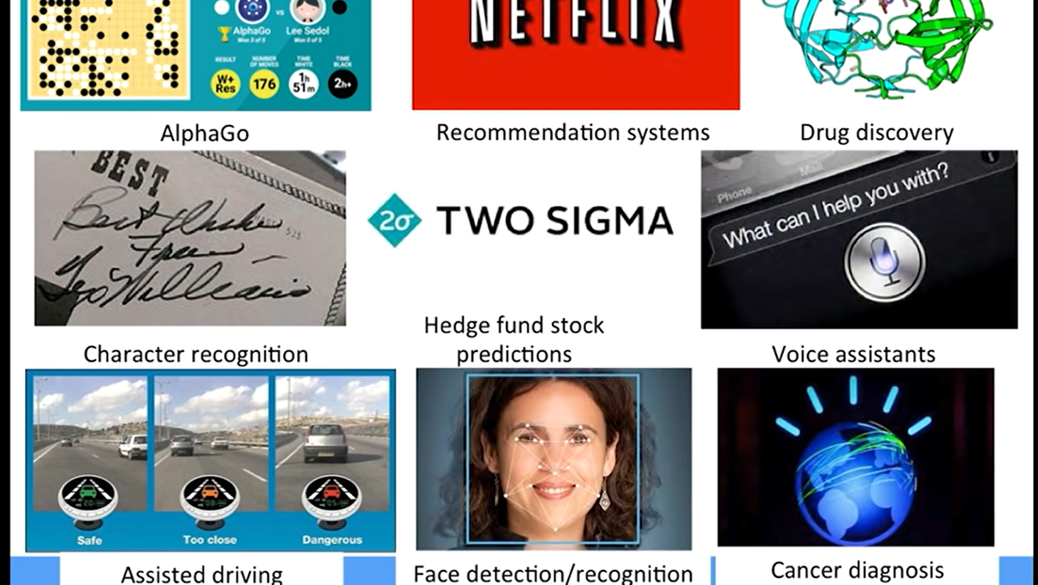

Slide 4
What Is Machine Learning?
All useful programs "learn" something
Early definition of machine learning:
"Field of study that gives computers the ability to learn without being explicitly programmed." Arthur Samuel (1959)
Computer pioneer who wrote first self-learning program, which played checkers - learned from "experience"
Invented alpha-beta pruning - widely used in decision tree searching

Slide 5
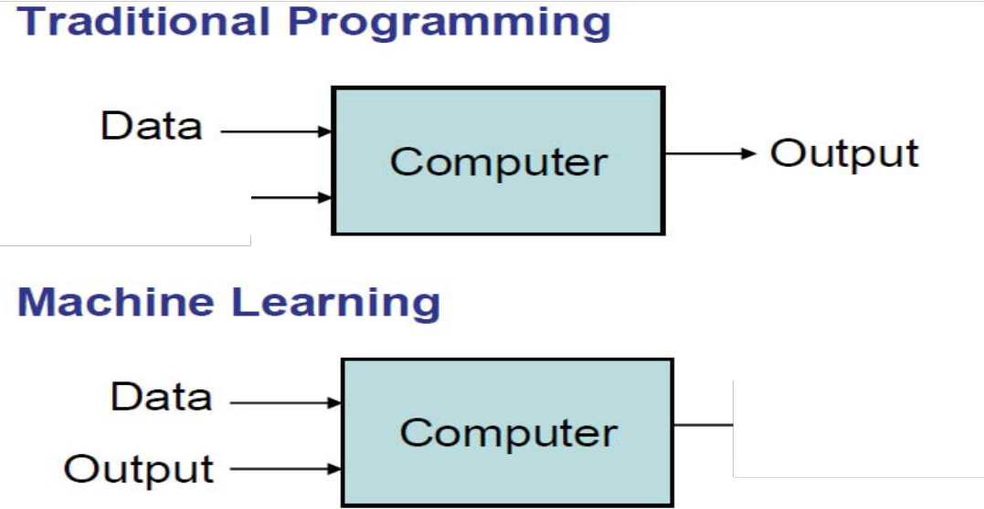
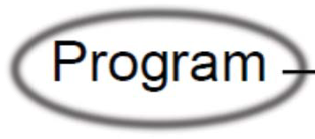
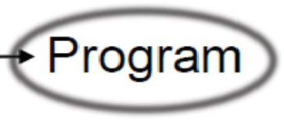
What Is Machine Learning?
Square root finder
Curve fitting by linear regression

Slide 6
What’s the Key?
We don’t tell the computer how to make predictions.
We give the computer old examples, it figures out how to make predictions itself.

Slide 7
Old Concepts, New Applications
That idea isn’t new (how do you predict if a restaurant will be good? If a job is worth applying for? If someone will date you?)
The scale, breadth, speed, and accuracy are new.

Slide 8
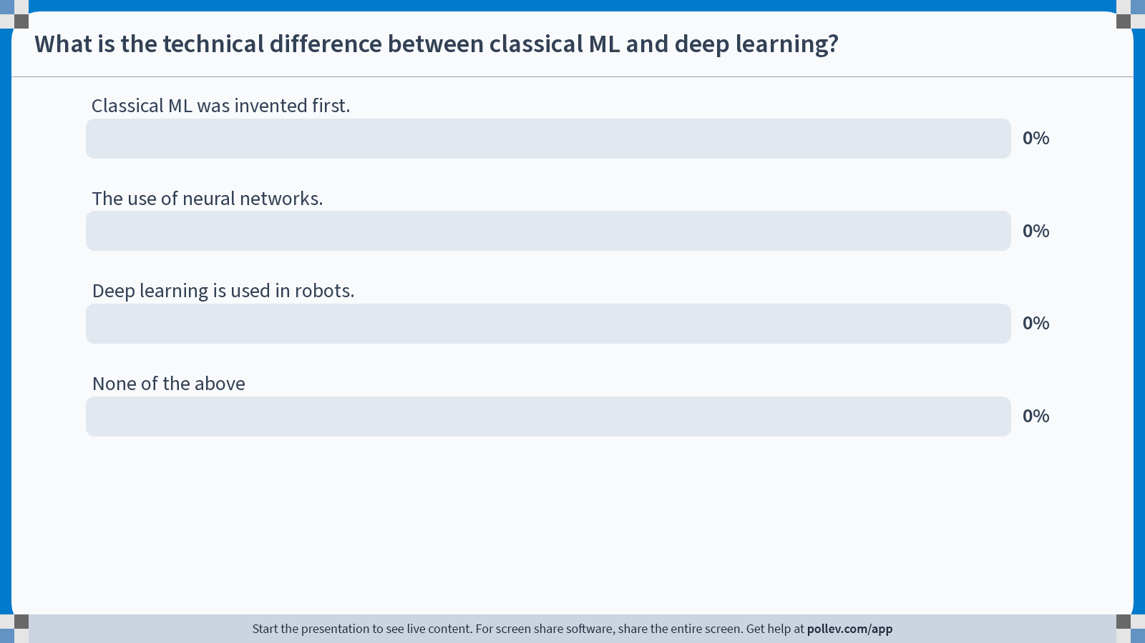
Notes:
Poll Title: Do not modify the notes in this section to avoid tampering with the Poll Everywhere activity. More info at polleverywhere.com/support What is the technical difference between classical ML and deep learning? https://www.polleverywhere.com/multiple_choice_polls/MO17GQ1moIjHu28CSz4Zi?state=opened&flow=Default&onscreen=persist

Slide 9
How Are Things Learned?
Interested in extending to programs that can infer useful information from implicit patterns in data
Memorization
Accumulation of individual facts
Limited by
Time to observe facts
Memory to store facts
Declarative knowledge
Generalization
Deduce new facts from old facts
Limited by accuracy of deduction process
Essentially a predictive activity
Assumes that the past predicts the future
Imperative knowledge

Slide 10
Basic Paradigm
Football players, labeled by position, with height and weight data
Observe set of examples: training data
Infer something about process that generated that data
Find canonical model of position, by statistics
Use inference to make predictions about previously unseen data: test data
Predict position of new players
Variations on paradigm
Supervised: given a set of feature/label pairs, find a rule that predicts the label associated with a previously unseen input
Unsupervised: given a set of feature vectors (without labels} group them into "natural clusters" (or create labels for groups}

Slide 11
What’s this Deep Learning Bit?
Deep Learning uses neural networks – one type of algorithm of machine learning.
The DL algorithm can be replaced with linear regression, trees, or any other algorithm and the concepts are the same.

Slide 12
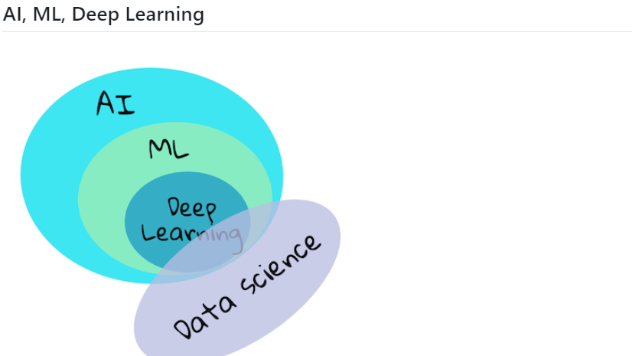
Notes:
The human brain
The human brain perceives things from the real world, processes the perceived information, makes rational decisions, and performs certain actions based on circumstances. This is what we called behaving intelligently. When we program a facsimile of the intelligent behavioral process to a machine, it is called artificial intelligence (AI).
Some terminology
Although the terms can be confused, machine learning (ML) is an important subset of artificial intelligence. ML is concerned with using specialized algorithms to uncover meaningful information and find hidden patterns from perceived data to corroborate the rational decision-making process.

Slide 13
Why Machine Learning?
✅ Think for a minute why a business would want to try to use machine learning strategies vs. creating a hard-coded rules-based engine.

Slide 14
Machine Learning Lingo
What? | Parameters | Structure | Hidden concepts
What from? | Supervised | Unsupervised | Reinforcement | Self-supervised
What for? | Prediction | Diagnosis | Compression | Discovery
How? | Passive | Active | Online | Offline
Output? | Classification | Regression | Clustering
Details?? | Generative | Discriminative | Smoothing

Slide 15
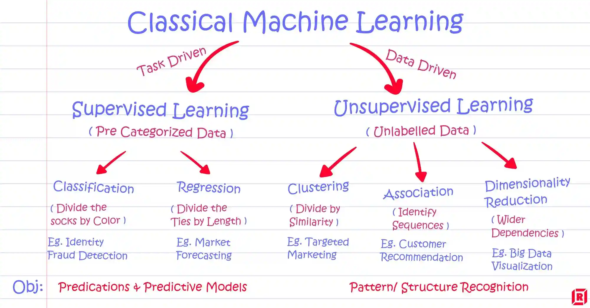

Slide 16

The Process is Simple
1 – Collect data on what we care about.
2 – ‘Clean’ that data up.
3 – Give the data to the algorithm to learn.
4 – Let the model generated from the algorithm make new predictions.

Slide 17
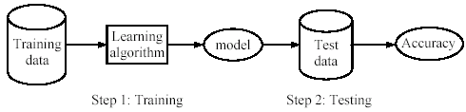
Supervised learning process: two steps
Learning (training): Learn a model using the training data
Testing: Test the model using unseen test data to assess the model accuracy

Slide 18
What do we mean by learning?
Given
a data set D,
a task T, and
a performance measure M,
a computer system is said to learn from D to perform the task T if after learning the system’s performance on T improves as measured by M.
In other words, the learned model helps the system to perform T better as compared to no learning.

Slide 19
Supervised Learning

Slide 20
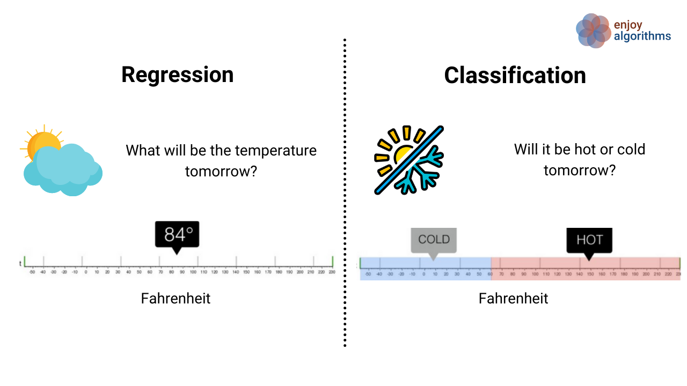

Slide 21
Regression

Slide 22
Linear Regression and Predictive Models
Most people have done linear regression before – it is making a line of best fit.
Result – y = m*x + b line.
M = slope, b = y intercept.
This process is also a simple predictive model – we provide X and get a prediction for Y.
The “regression calculation” uses the training data to “learn” how to generate Y from X.
That’s the machine learning bit.
The process of creating a regression is almost the same as other models, we’ll do later.

Slide 23
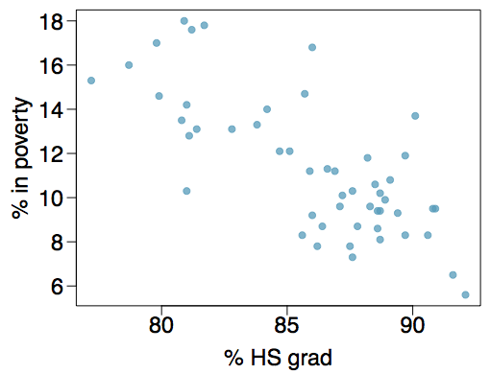
Poverty vs. HS graduate rate
The scatterplot below shows the relationship between HS graduate rate in all 50 US states and DC and the percent of residents who live below the poverty line (income below $23,050 for a family of 4 in 2012).

Slide 24
Poverty vs. HS graduate rate
We could draw a line of best fit… but how do we know exactly where it goes?

Slide 25
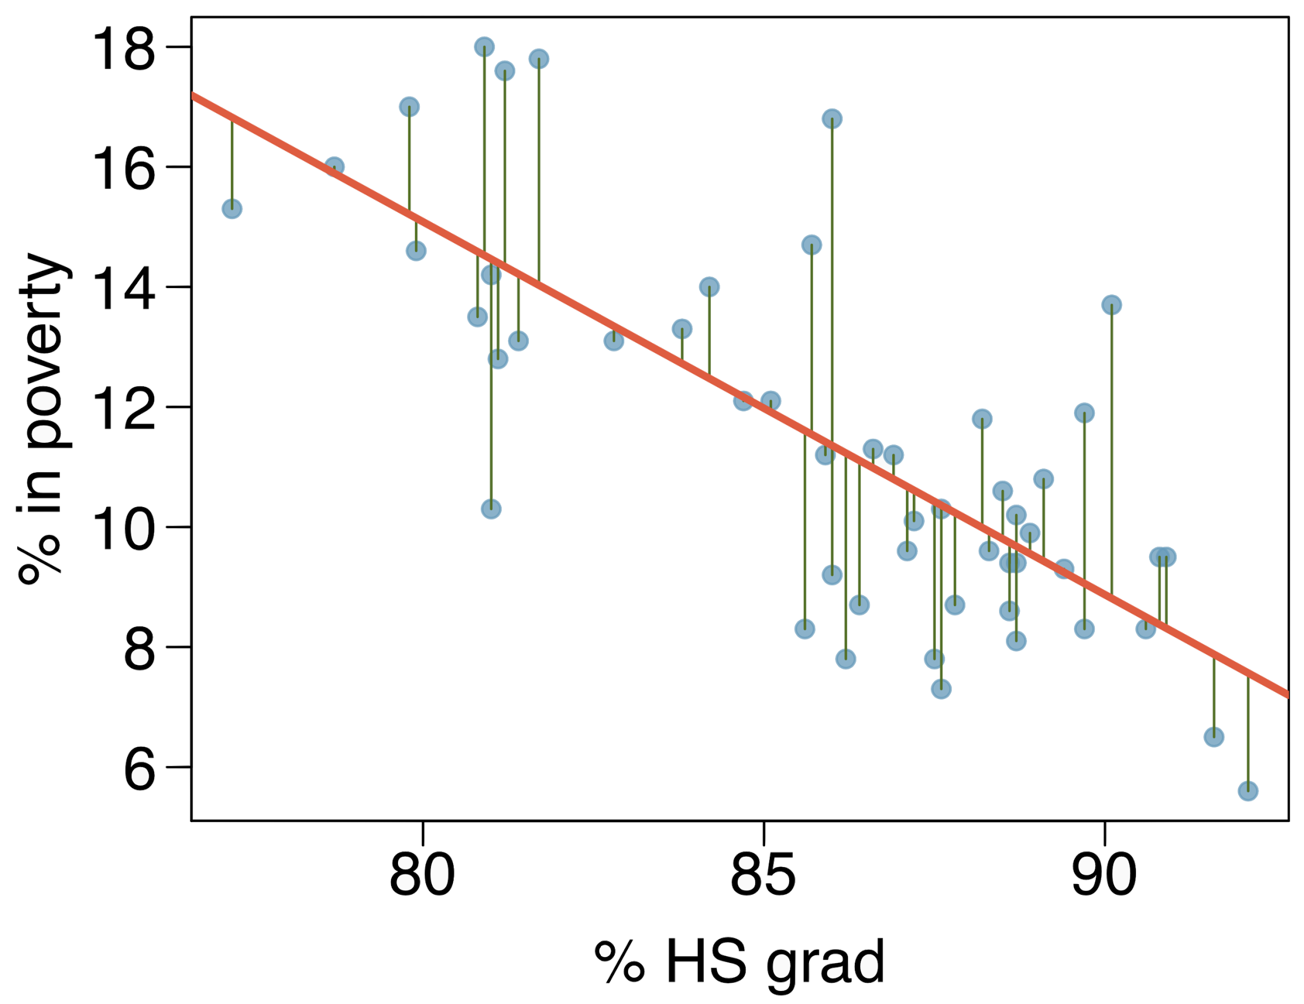
Residuals
Residuals are the leftovers from the model fit:
Data = Fit + Residual

Slide 26
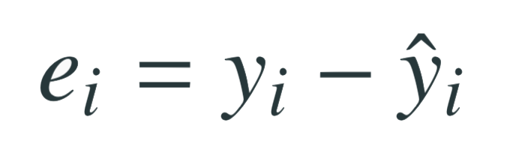
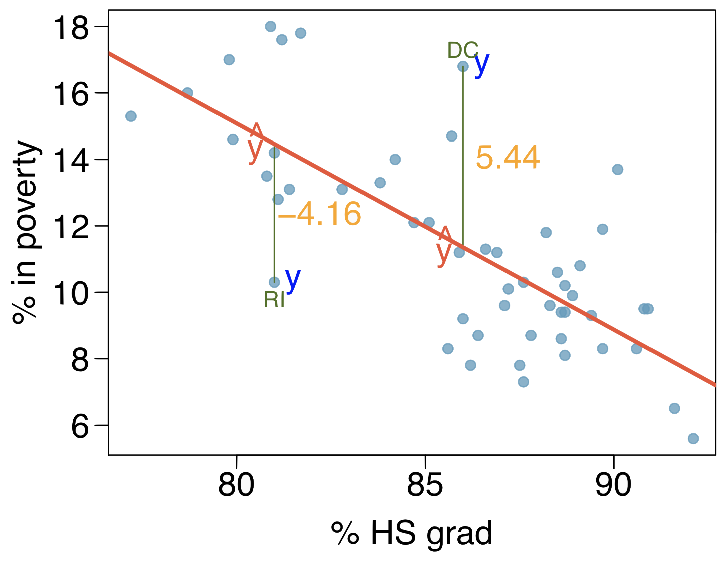
Residuals (cont.)
Residual is the difference between the observed (y_{i}) and predicted ŷ_{i}.
% living in poverty in DC is 5.44% more than predicted.
% living in poverty in RI is 4.16% less than predicted.

Slide 27
Other Packages
Linear regression is performed by many existing packages, such as StatsModels, Scipy, and Scikitlearn.
The book uses StatsModels when multiple regression starts.
Which you use mostly doesn’t matter, it is a personal choice.
We’ll use both StatsModels and Scikitlearn:
Statsmodels provide more stats data in the output, so we will use that sometimes.
The scikitlearn is probably more relevant experience for ML stuff.
I think going forward I might replace some of the statsmodels examples in future workbooks with sklearn one. The interface is easier, and it is more relevant to ML.

Slide 28
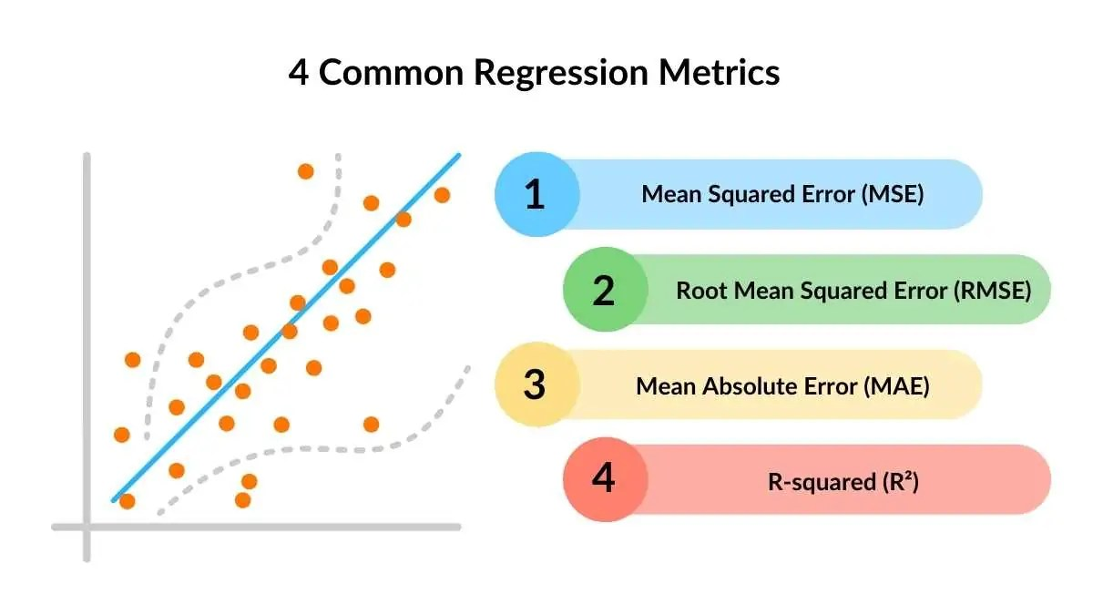

Slide 29
Conclusion
We can train our models to predict Y, given X.
In this case, the model is a simple algebra equation.
This is a simple version of all the more complex ML work to come later.
The residuals give us information on how good our model is.
Accuracy and reliability of the predictions.

Slide 30
CLASSIFICATION

Slide 31
What is classification?
A machine learning task that deals with identifying the class to which an instance belongs
A classifier performs classification
Classifier
( Textual features : Ngrams )
( Age, Marital status,
Health status, Salary )
( Perceptive inputs )
Test instance
Attributes
(a1, a2,… an)
Discrete-valued
Class label
Category of document? {Politics, Movies, Biology}
Steer? { Left, Straight, Right }
Issue Loan? {Yes, No}

Slide 32
Classification learning
Training
phase
Testing
phase
Learning the classifier
from the available data
‘Training set’
(Labeled)
Testing how well the classifier
performs
‘Testing set’

Slide 33
An example application
An emergency room in a hospital measures 17 variables (e.g., blood pressure, age, etc) of newly admitted patients.
A decision is needed: whether to put a new patient in an intensive-care unit.
Due to the high cost of ICU, those patients who may survive less than a month are given higher priority.
Problem: to predict high-risk patients and discriminate them from low-risk patients.

Slide 34
Another application
A credit card company receives thousands of applications for new cards. Each application contains information about an applicant,
age
Marital status
annual salary
outstanding debts
credit rating
etc.
Problem: to decide whether an application should approved, or to classify applications into two categories, approved and not approved.

Slide 35
The data and the goal
Data: A set of data records (also called examples, instances or cases) described by
k attributes: A₁, A₂, … A_{k}.
a class: Each example is labelled with a pre-defined class.
Goal: To learn a classification model from the data that can be used to predict the classes of new (future, or test) cases/instances.
Notes:
Induction is different from deduction and DBMS does not not support induction;
The result of induction is higher-level information or knowledge: general statements about data
There are many approaches. Refer to the lecture notes for CS3244 available at the Co-Op.
We focus on three approaches here, other examples:
Other approaches
Instance-based learning
other neural networks
Concept learning (Version space, Focus, Aq11, …)
Genetic algorithms
Reinforcement learning

Slide 36
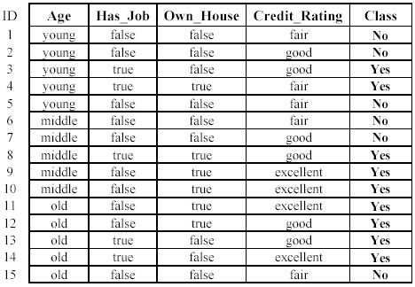
An example: data (loan application)
Approved or not

Slide 37
An example: the learning task
Learn a classification model from the data
Use the model to classify future loan applications into
Yes (approved) and
No (not approved)
What is the class for following case/instance?

Slide 38
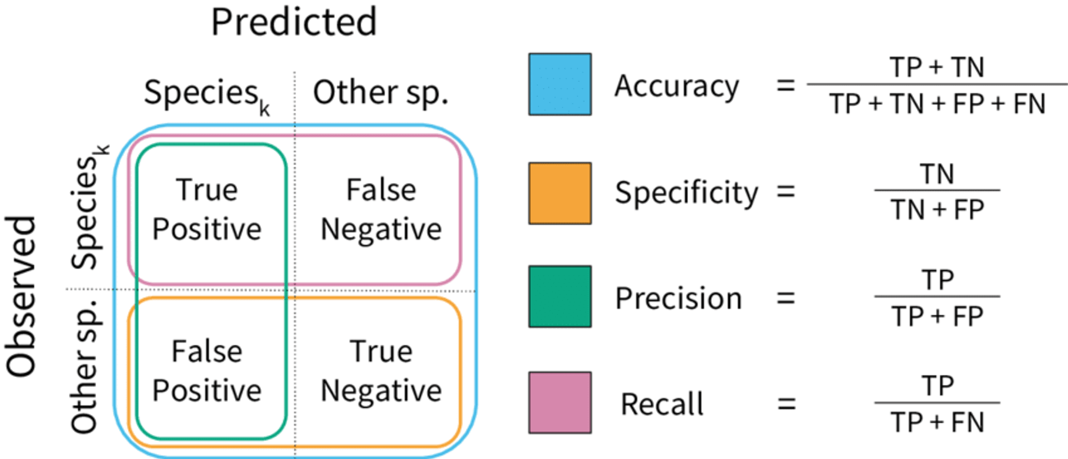

Slide 39
Conclusion
Logistic regression introduces us to a few things:
Alternate cost functions – depending on the scenario, we can switch between cost calculations.
Multiple class predictions – processes mostly the same, but the prediction processing is different.
In sklearn, regularization (L2) is enabled by default.

